Slide 1

GROUP 7 PRESENTS
LIBRARY MANAGEMENT SYSTEM

Slide 2
INTRODUCTION
Our Project is based on Library Management.
A simple Library Management that provides facilities like login, issue/return books, search, add books, remove books.
It keeps track of all the transactions that takes place in the library.

Slide 3
FLOWCHART OF THE PROGRAM

Slide 4
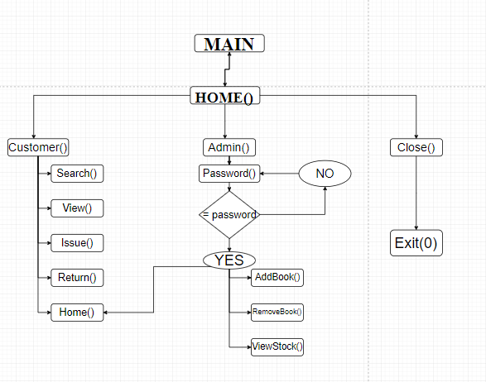

Slide 5
Data Structure Used
Link Lists
Structures
Arrays
Strings

Slide 6
SCREENSHOTS

Slide 7
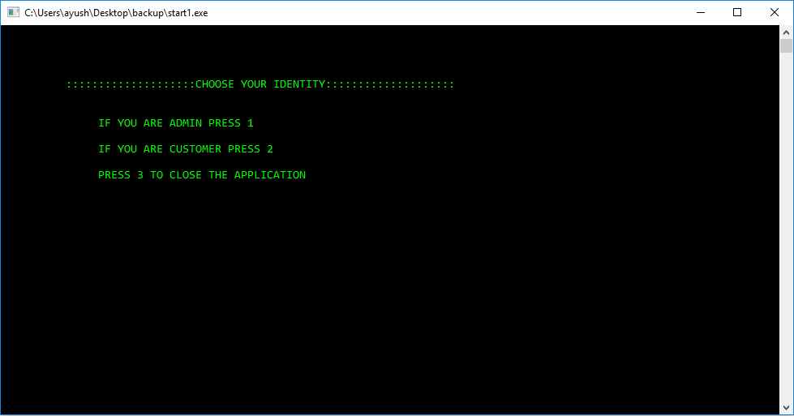
HOME

Slide 8
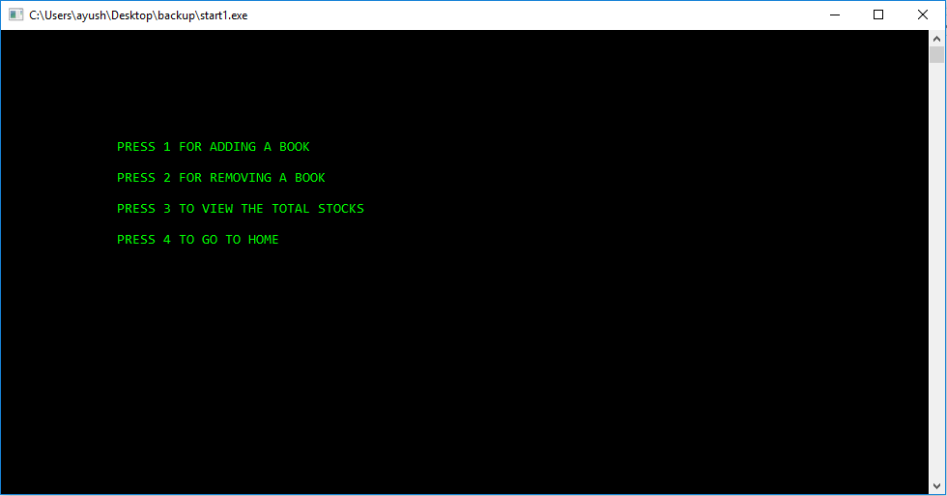
ADMIN OPTION

Slide 9
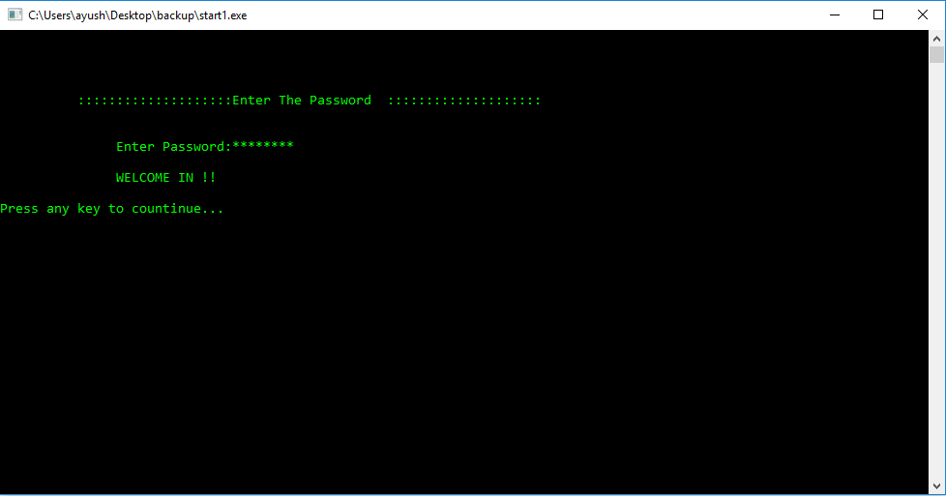
PASSWORD

Slide 10
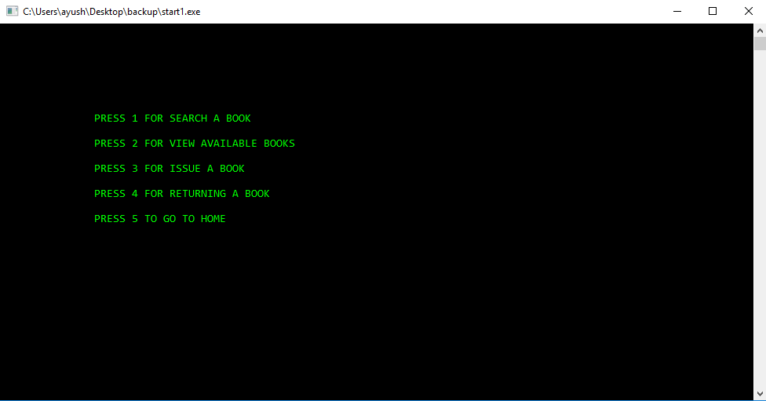
CUSTOMER OPTIONS

Slide 11
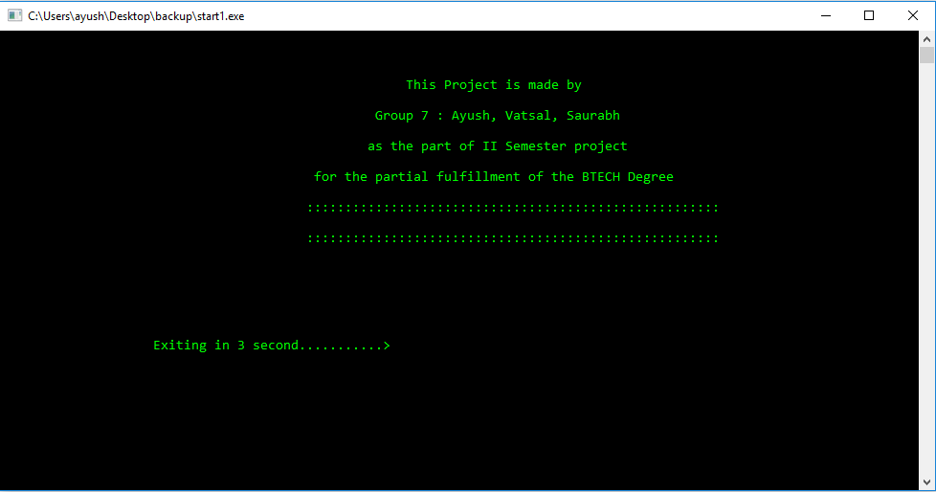
CLOSE THE APPLICATION OPTION

Slide 12
LETS SEE THE WORKING OF THE APPLICATION AND THE CODE

